Slide 1
Smart Valve Assembly Process Improvement
31/01/2020

Slide 2
Problem Definition
Problem: Unstandardized smart valve(SV) assembly method
Cause: Lack of a specialized tool to assemble the dock part 1 and the dock holder hence use of a canister
Impact :
Deformation/misalignment of SV parts (since monitoring the parts motion is difficult)
Leaking SV
Wear and tear on the canisters (since any canister can be used)
Variable time to assemble
Waste of time aligning the pinhole

Slide 3
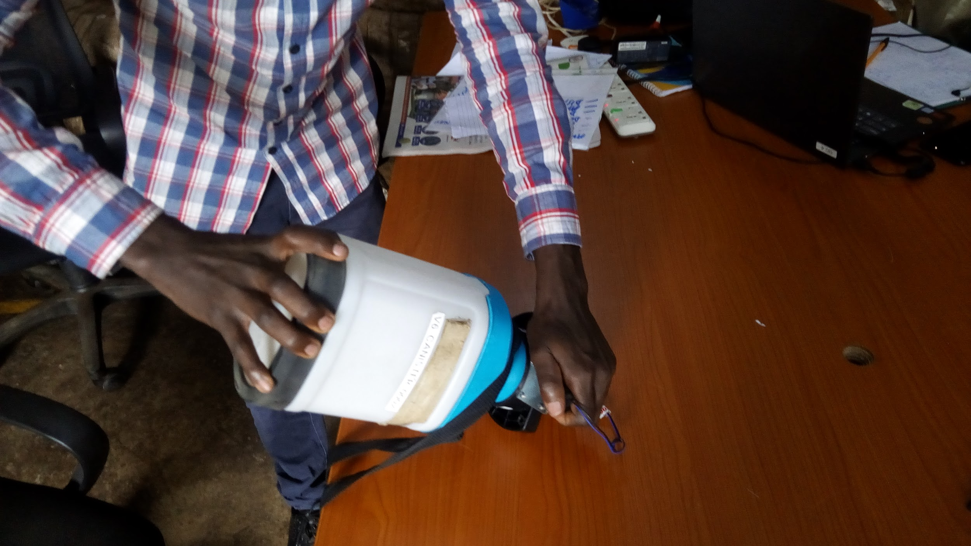
Current Practice

Slide 4
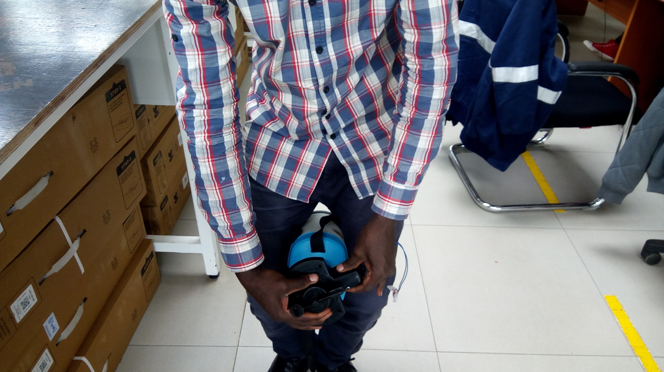
Pictures Cont.

Slide 5
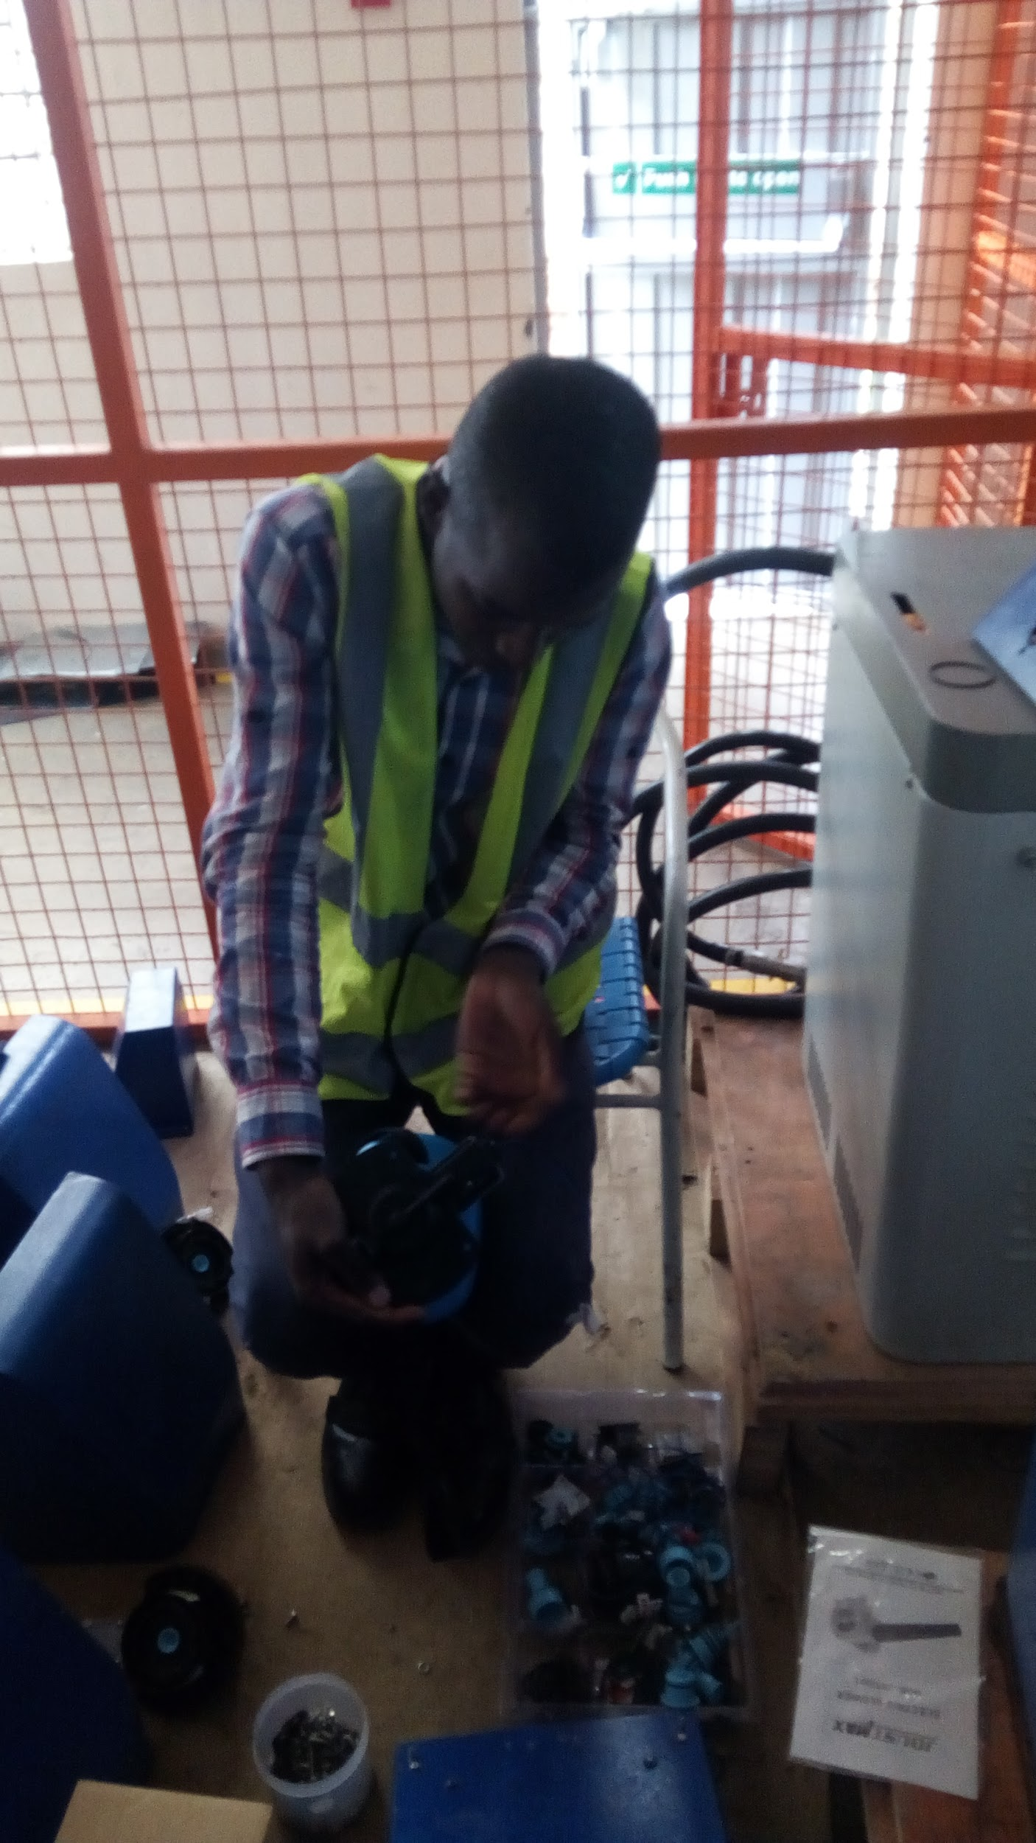
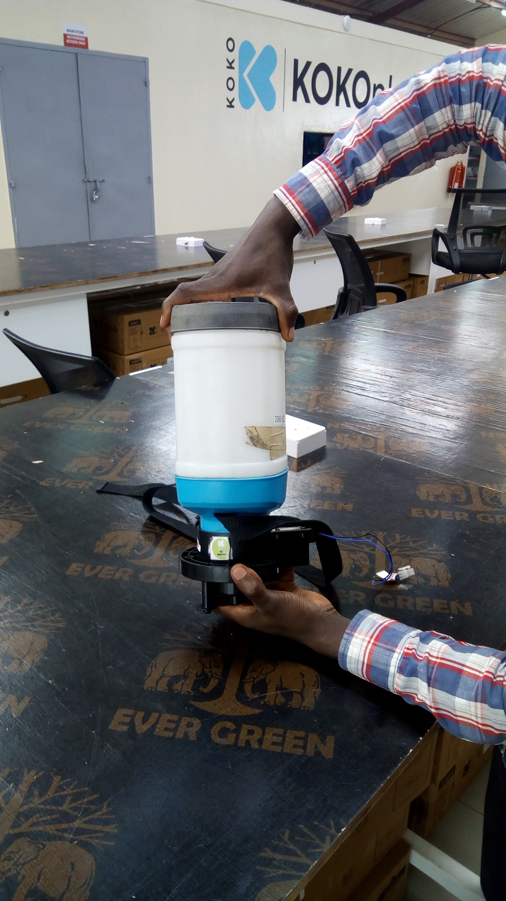
Pictures Cont.

Slide 6
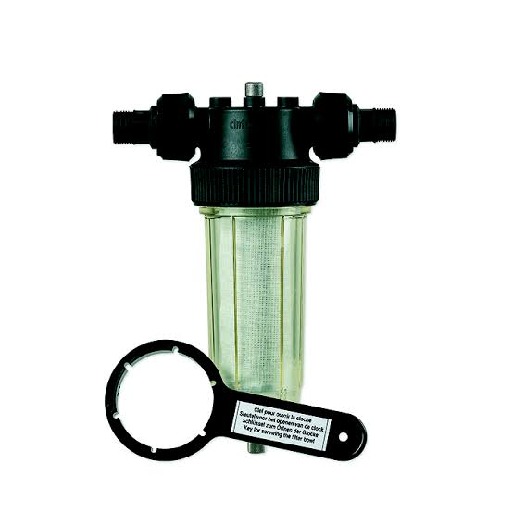
Industry Practices
Filters uses a housing wrench to screw and unscrew the filter housing from the cap
wrench

Slide 7
Project Proposal
Requirements for a specialized assembly tool
A rig to hold the dock holder in place -the current practice is by using the hand as support during assembly
A tool to screw and unscrew dock part 1-the current practice is to clamp down the canister with your feet or arm when assembling the two parts

Slide 8
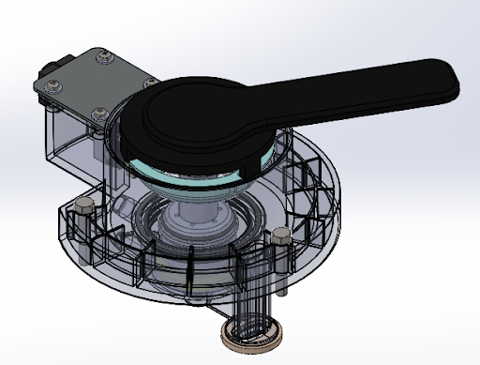
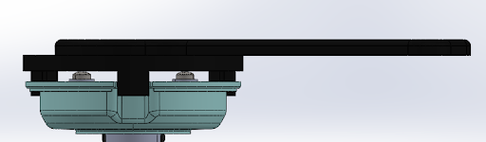
Tool Concept

Slide 9
Expected Outcome
Standardized and repeatable assembly method.
Reduced time to align the dock part 1 and dock holder pinhole to put the lockpin.
Less likely defects in the smart valve that result in miasaligned o-rings, leakages and aborted dispenses.
This would result in increased customer satisfaction, increase in ALPU and more KP uptime due to properly assembled dock parts.

Slide 10
m.ceesay@kokonetworks.com d.kaboshi@kokonetworks.com

